Slide 1


PEER MENTORING
ANKITA THAKUR
SHAVITA SONIA
VAISHALI ARORA
AMANDEEP KAUR
VEERPAL KAUR
DILPREET KAUR
RIPANDEEP KAUR
(M.Sc. Botany)
SEEMA
PARIKA
PRIYA KAUR
GAGANDEEP KAUR
SALONI

Slide 2


NIDHI SHARDA
RAMAN MANPREE KAUR
MEENU
NIVEDITA MAHAJAN
INDU BALA
TANIYA
DIVNOOR
NANCY SHARMA
NISHTHA
KAJAL SHARMA
RIYA THAKUR
AMARPREET KAUR
Rohini
(M.Sc. Botany)
RACHANA RAWAT
PINKY KATARIA
KRISHMA
TANIYA
NEHA

Slide 3
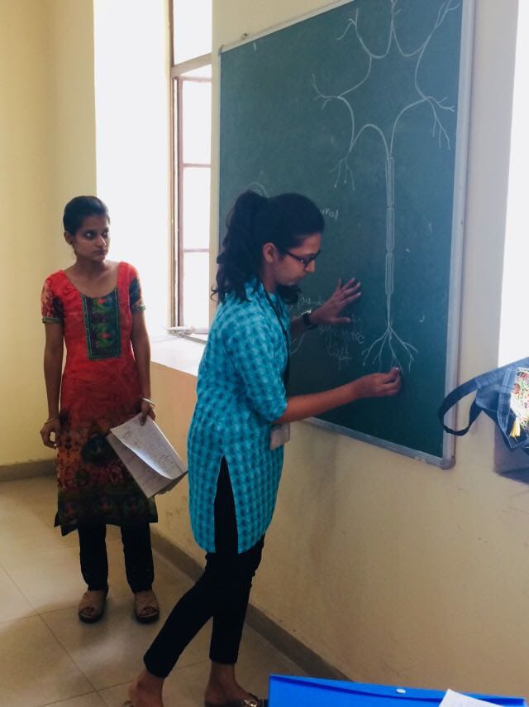
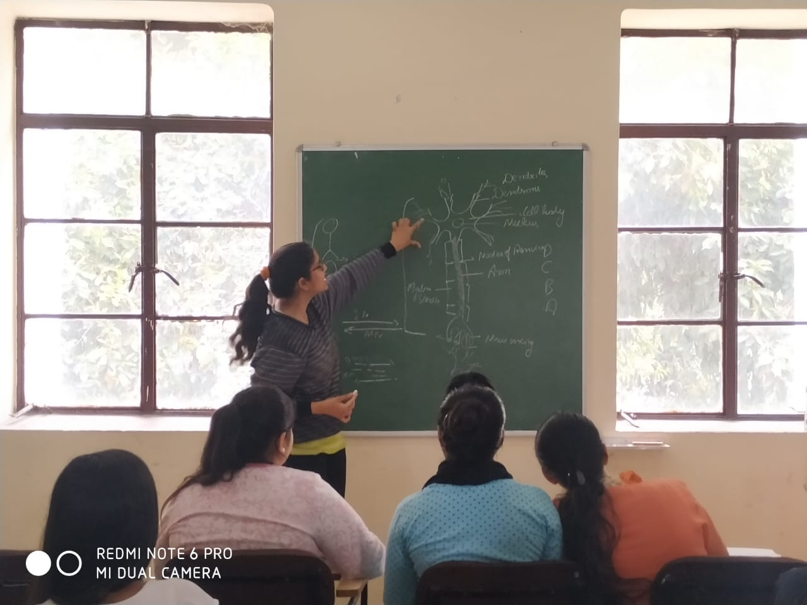
PEER MENTORING

Slide 4
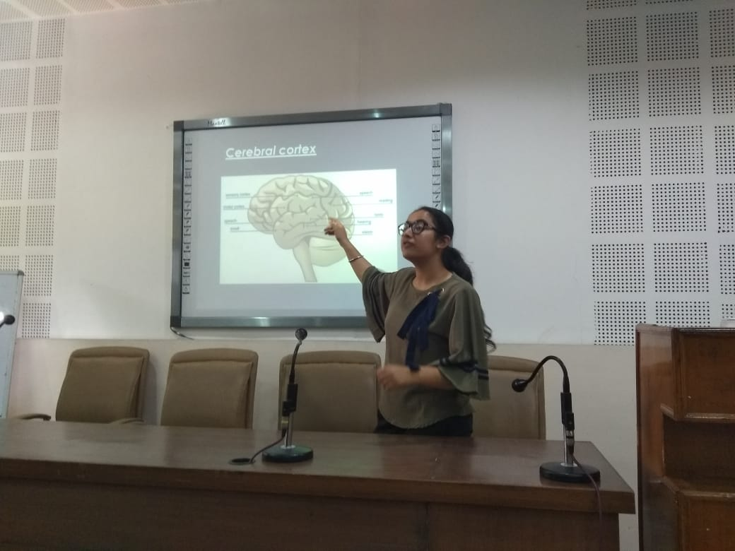
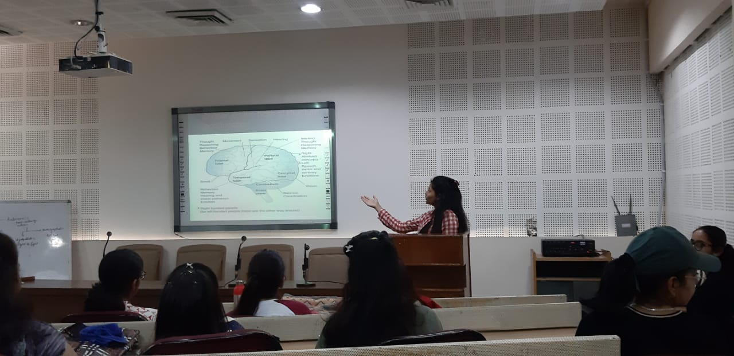
PEER MENTORING

